Slide 1
DESIGN AND IMPLEMENT A MONGODB DATABASE
PRESENTED BY
K.ARUNKUMAR (912421106001)
V.ATCHAYA (912421106002)

Slide 2

MongoDB: The Modern Database Solution
MongoDB is a leading NoSQL database that provides a flexible, scalable, and high-performance data storage and retrieval solution for modern applications.
Its unique document-oriented data model, robust querying capabilities, and seamless scalability make it a popular choice among developers and enterprises.

Slide 3

What is MongoDB?
1
Document-Oriented Database
2
NoSQL Approach
MongoDB departs from the traditional relational database model, offering a more flexible and scalable alternative.
MongoDB stores data in flexible, JSON-like documents, allowing for dynamic and schema-less data models.
3
Distributed Architecture
MongoDB's sharding capabilities enable horizontal scaling, distributing data across multiple servers for high availability and performance.

Slide 4
Key Features and Benefits
Flexible Data Model
High Performance
Scalability
MongoDB's document-oriented approach allows for dynamic schema changes, making it easy to adapt to evolving application requirements.
With its efficient indexing, aggregation, and querying capabilities, MongoDB delivers lightning-fast data access and processing.
MongoDB's horizontal scaling through sharding enables handling large data volumes and heavy workloads with ease.

Slide 5
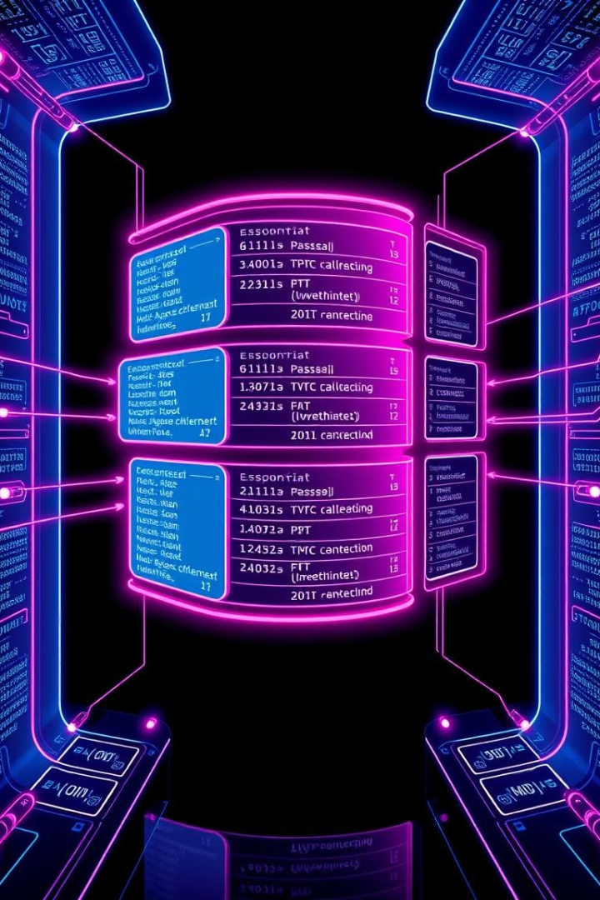
Data Modeling in MongoDB
Denormalized Data
Embedded Documents
MongoDB's document-oriented model allows for denormalized data storage, reducing the need for complex joins.
Related data can be stored together in a single document, enabling efficient retrieval and update operations.
Dynamic Schemas
Query Optimization
MongoDB's flexible schema allows for easy adaptation to changing application requirements without complex schema migrations.
MongoDB's indexing and query optimization features ensure fast and efficient data retrieval.

Slide 6
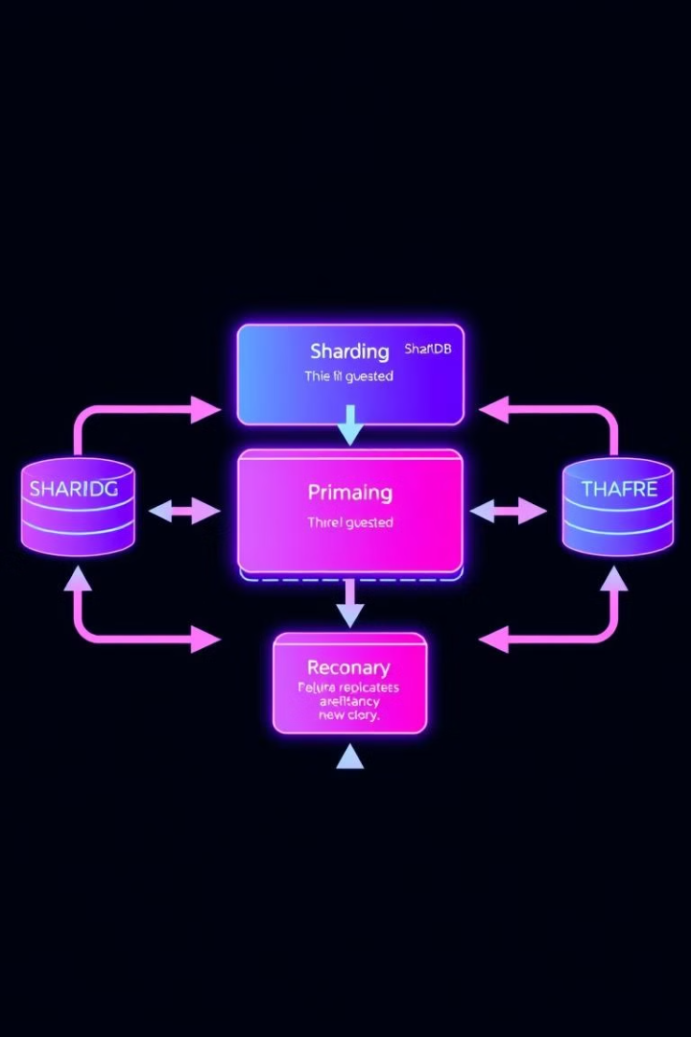
Scalability and High Availability
Horizontal Scaling
1
MongoDB's sharding feature enables seamless horizontal scaling by distributing data across multiple servers.
Replication
2
t-in replication ensures high availability and data redundBuilancy, providing failover and read scaling capabilities.
Fault Tolerance
3
MongoDB's robust architecture and automatic failover mechanisms ensure continuous operation even in the event of hardware or network failures.

Slide 7





MongoDB Query Language
Find
Update
qPowerfuluerying capabilities to locate and retrieve specific data.
Seamless data modification and manipulation within the database.
Insert
Delete
Efficient addition of new data to the MongoDB database.
Precise removal of data from the MongoDB database.

Slide 8




Aggregation and Analytics
Data Transformation
Real-Time Analytics
Flexible Reporting
MongoDB's aggregation pipeline allows for complex data transformation and manipulation.
Powerful aggregation capabilities enable real-time analytics and business intelligence on MongoDB data.
The aggregation framework provides a flexible and extensible way to generate custom reports.

Slide 9

Integrating MongoDB with Applications
Programming Languages
MongoDB provides official drivers for popular languages like Java, Python, Node.js, and more.
Web Frameworks
Seamless integration with web frameworks like Express.js, Django, and Spring Boot.
Business Intelligence
Easily integrate MongoDB data with BI tools like Tableau, Power BI, and Qlik.
Big Data Ecosystems
Leverage MongoDB's flexibility in big data environments like Hadoop and Spark.

Slide 10
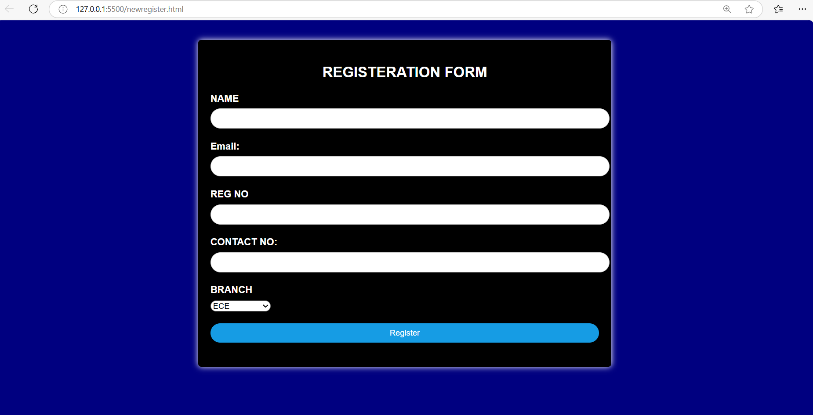
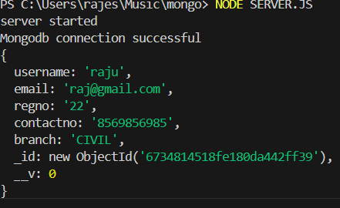

Slide 11
Conclusion:
MongoDB is an excellent choice for applications that need to scale horizontally, handle a variety of data types, and provide high availability. It’s ideal for developers who prioritize flexibility in data storage and speed in development, but it requires careful attention to how data is modeled and indexed to ensure optimal performance. As with any database, the choice of MongoDB should depend on the specific needs and constraints of your application.

Slide 12


